Slide 1



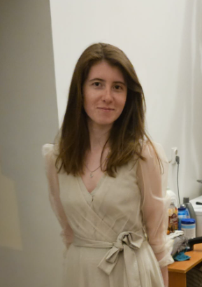

Seismic Detection
Across the Solar System
Algorithms that can help identify and sort seismological events
Alpha Wolves
Piotr
Szarow
Team Leader
Tomasz
Desaniuk
Programmer
Szymon
Drabik
Analyst
Oliwia
Cerkowniak
Graphic designer
Krystian
Bienkowski
Barista

Slide 2
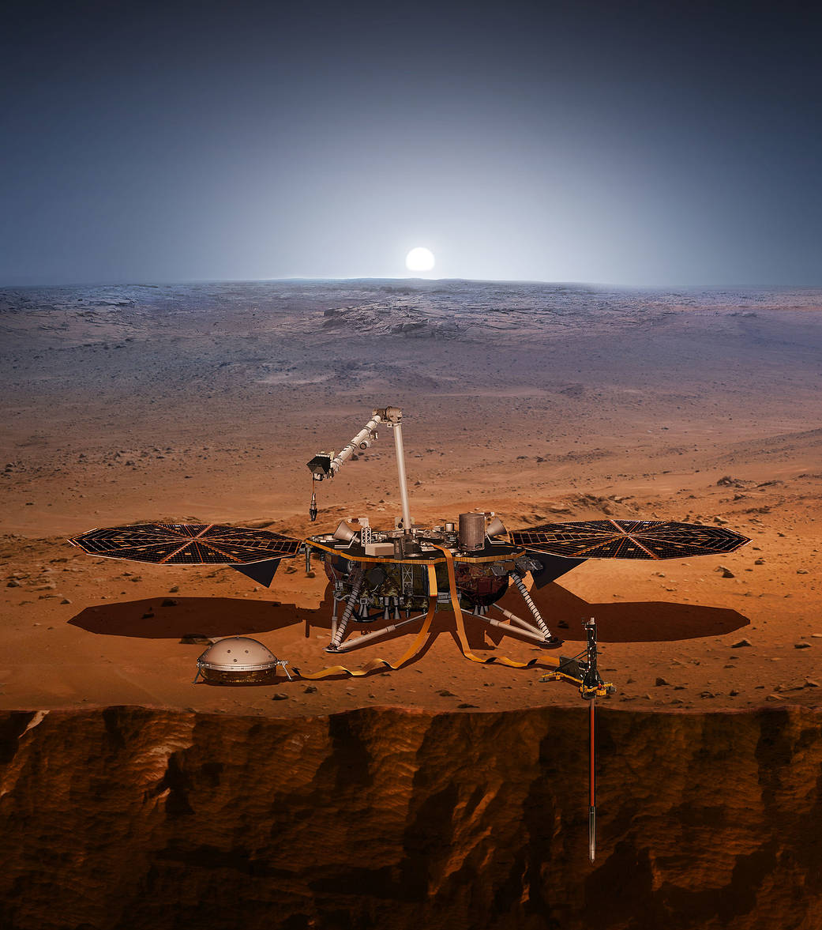
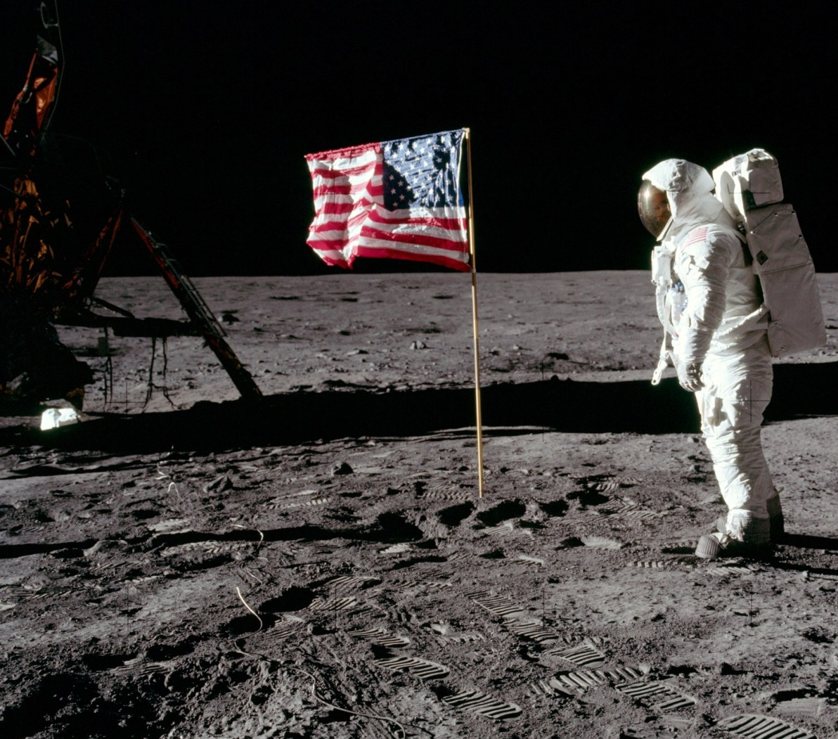
Data analysis based on the Apollo and Mars InSight Lander missions
Challenge:
We need seismic data from the Moon and Mars to protect connections and prepare sites for landing. Due to the large amount of energy needed to process them, performance must be taken into account, which involves external costs or algorithms that are only perceived by data such as an earthquake.
Solution:
The solution proposed by our team is an algorithm that allows you to obtain the necessary data while maintaining the rover's energy efficiency and optimalized for real time operations.

Slide 3

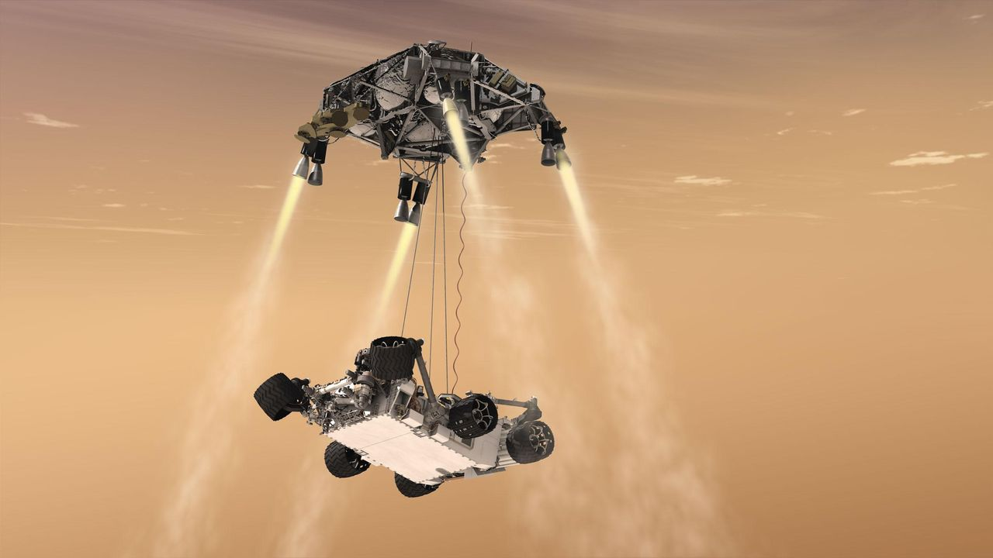
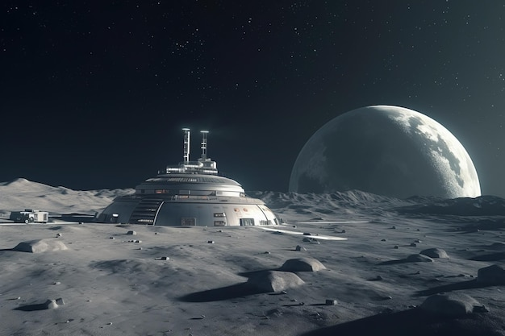
Application of the algorithm
Finding safe places to land
Seismic vibration testing to select appropriate materials for the construction of space equipment
Detect and analyze seismic vibrations and find guidelines to help predict quakes.
Learning about the geological structure of the planet
Preventing the destruction of space stations
The analyzed data can be used for machine learning

Slide 4
System ekspertowy oraz system decyzyjny
Expert System
Decision System
Its task is to verify the type of threat resulting from planetary seismic activity based on the adopted assumptions
It enables a quick response to specific seismological phenomena
It allows the implementation of output data into machine learning algorithms
It involves analyzing seismic motion graphs and notifying the user in case of deviations from the norm

Slide 5
Simplicity in data processing
Loading and Processing Data
Filtering the Data
Seismic Event Detection using STA / LTA Algorithm
Plotting Data and Spectrograms
Saving Detected Events
Gathering results and verify the data

Slide 6
Sources:
https://tech.wp.pl/mars-2020-latajacy-dzwig-ladowanie-lazika-perseverance,6611186310994784a
https://pl.freepik.com/premium-zdjecie/baza-kosmiczna-na-niezamieszkanej-planecie-i-blisko-ksiezyca_59080445.htm
https://www.nasa.gov/

